Slide 1

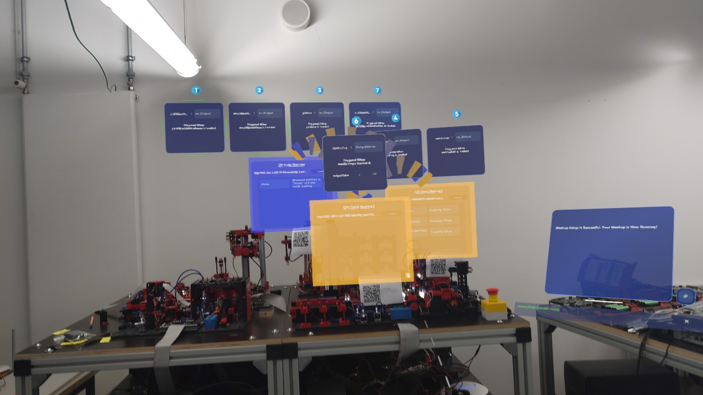
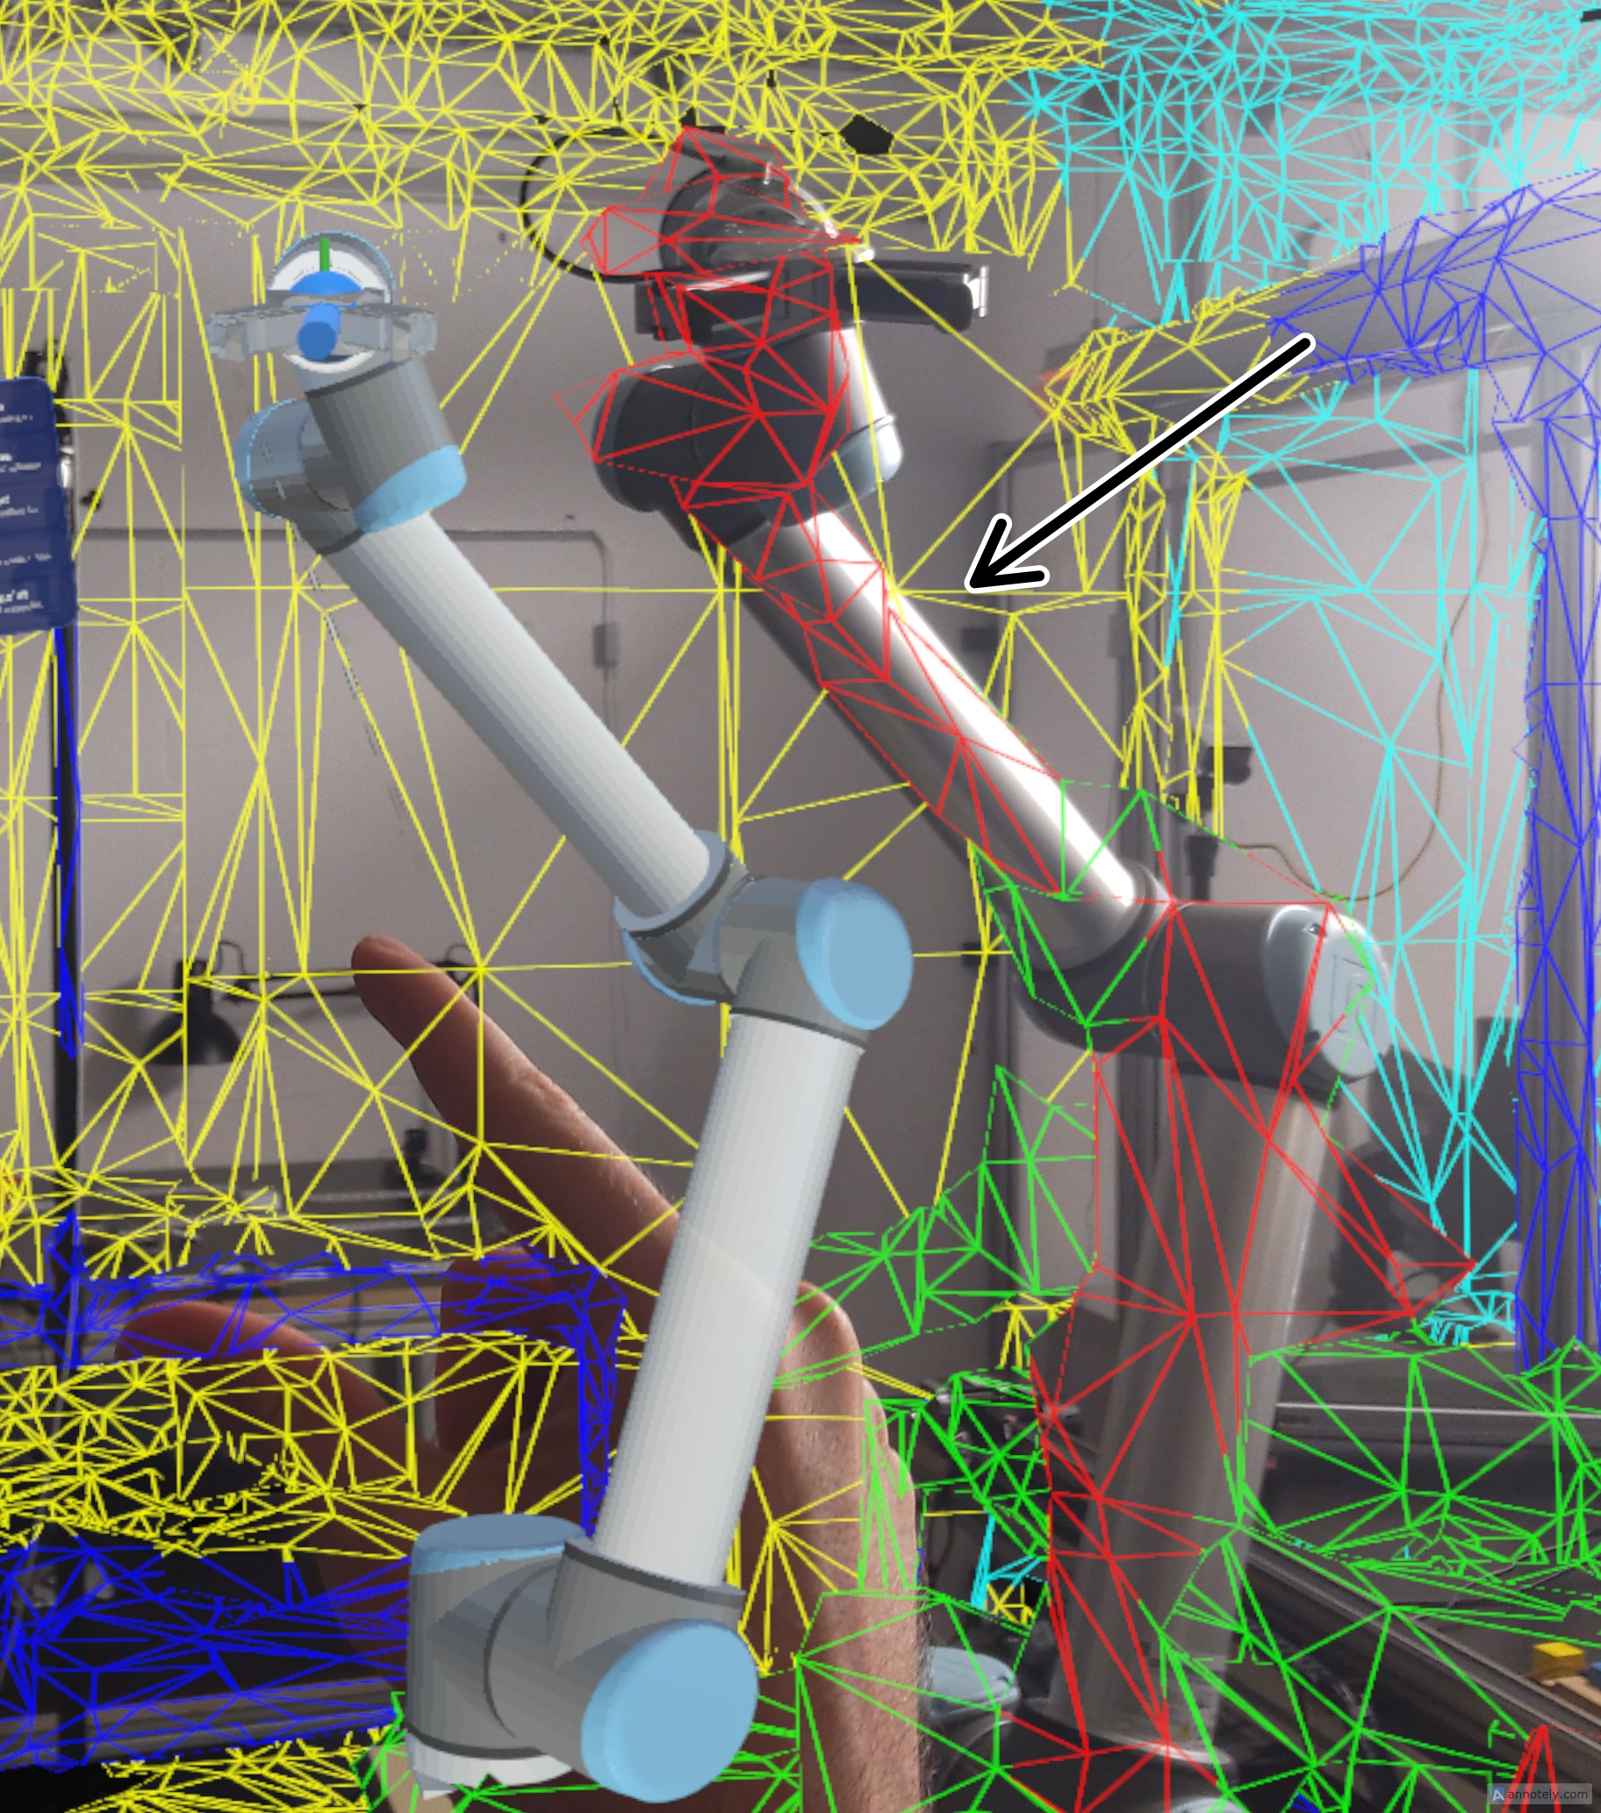
Onboarding and Interoperability in the Metaverse
Background/Motivation:
View and access devices without any need for middleware
Use 3D assets for visualization in a spatial context
Control devices and generate Mashups on the fly
What can be seen:
HoloWoT: viewing device properties using holographic
RoboLens: controlling any robot arm using only its TD and URDF
HoloWoT
RoboLens

